Slide 1





Slide 2
Tranquility Bay Residence, a premier boutique development
located on over 230 meters of private beach on the island of
Koh Chang, Thailand.
Tranquility Bay Residence comprises of one to four bedroom luxury condominium units and a select handful of the finest pool villas, nestled amongst landscaped gardens with stunning vistas of 52 outlying islands in Koh Chang National Marine Park.
Built to internationally recognized construction standards and designed to complement and reflect Koh Chang's natural beauty, Tranquility Bay Residence affords buyers a lifestyle and investment opportunity attractive to both permanent residents and investors.

Slide 3
TRANQUILITY BAY RESIDENCE OFFERS
60 sq.m. 1 Bedroom fully furnished
120 sq.m. 2 Bedroom Duplex fully furnished
120 sq.m. 2 Bedroom Penthouse fully furnished
Pool villas 323-558 sq.m.
facilities and services
  Beachfront restaurant & bar Spa
  Private Jetty Yacht charter
  Excursions Wifi
  BBQ grills Private dining
  Infinity edge swimming pool Clubhouse & recreation
  Library offering complimentary dvd & music cd rentals

Slide 4
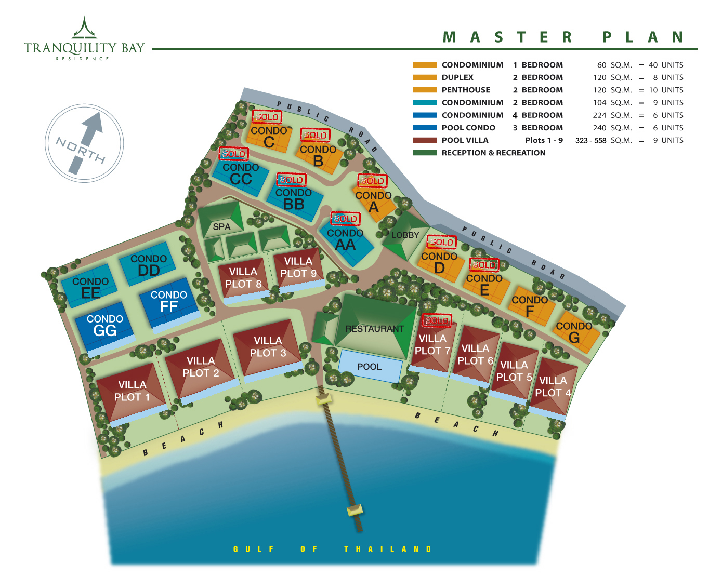

Slide 5
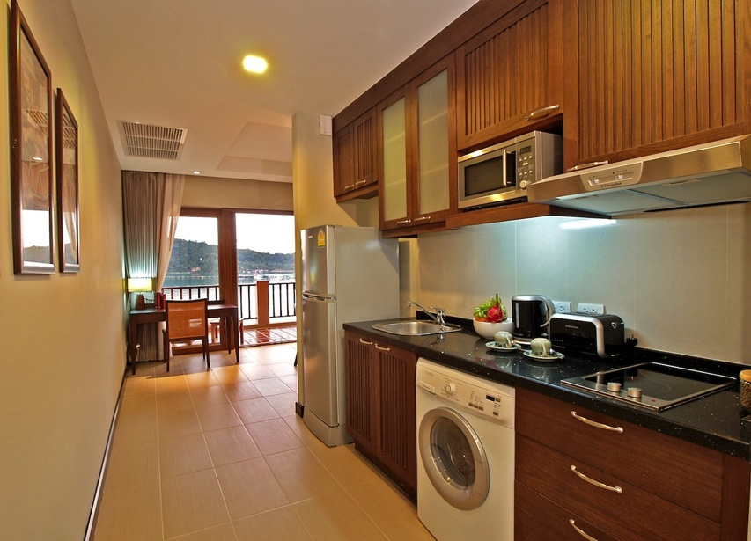
60 sq.m. 1 bedroom fully furnished
Price starts from Baht 6.8M

Slide 6
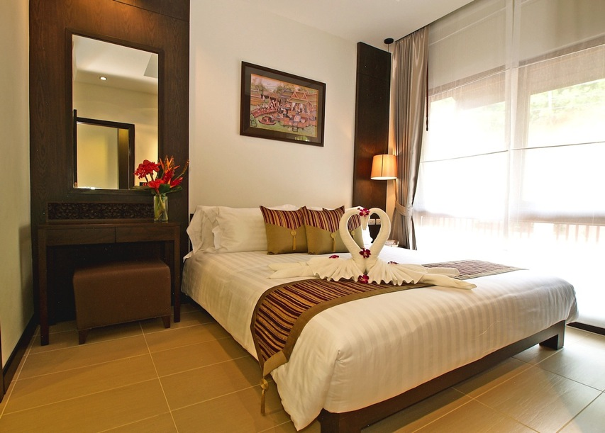
60 sq.m. 1 bedroom fully furnished

Slide 7
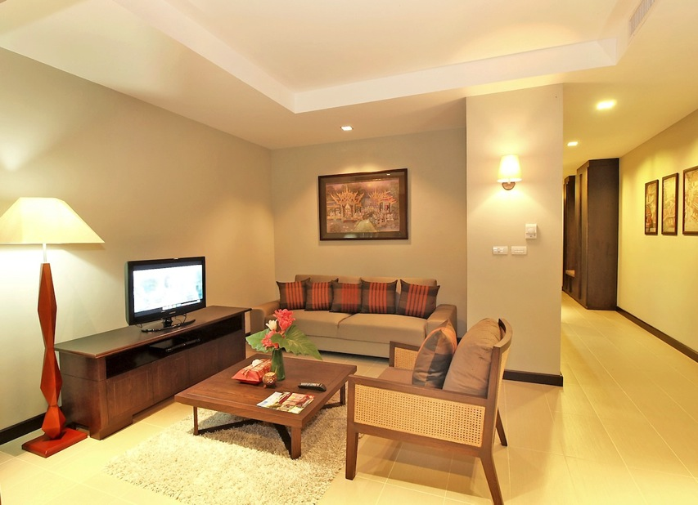
60 sq.m. 1 bedroom fully furnished

Slide 8
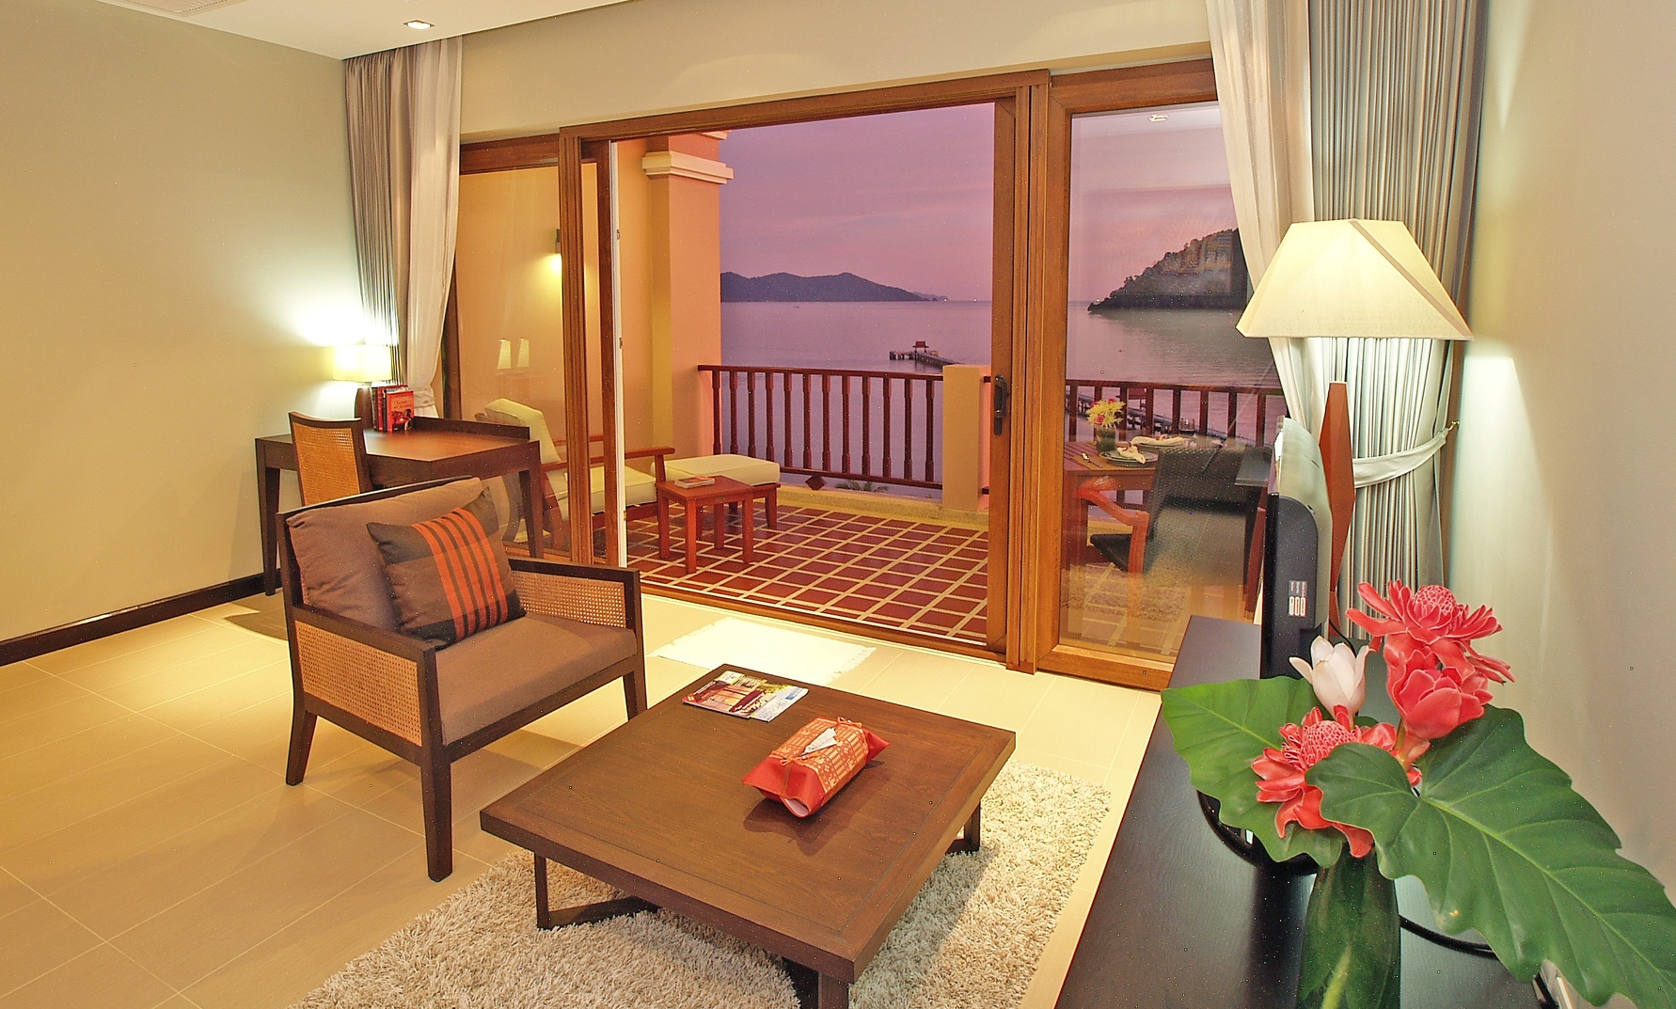
60 sq.m. 1 bedroom fully furnished

Slide 9
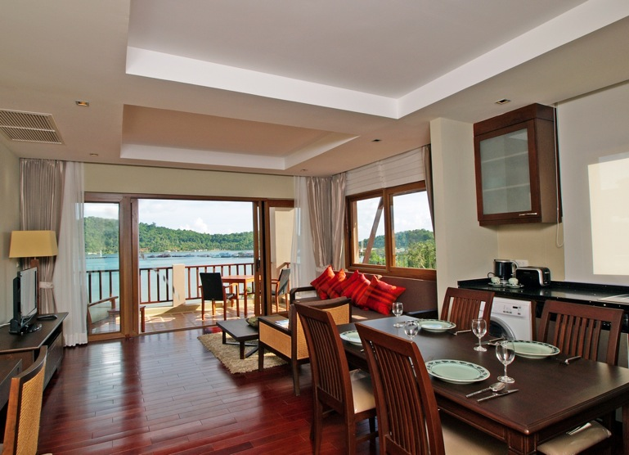
120 sq.m. 2 bedroom Duplex fully furnished
Price starts from Baht 12.5M

Slide 10
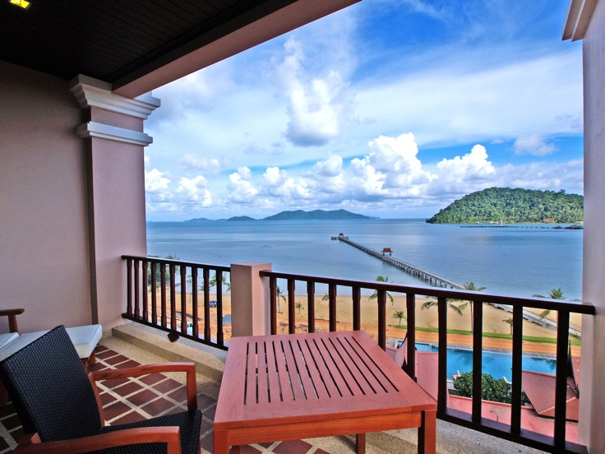
120 sq.m. 2 bedroom Duplex fully furnished

Slide 11
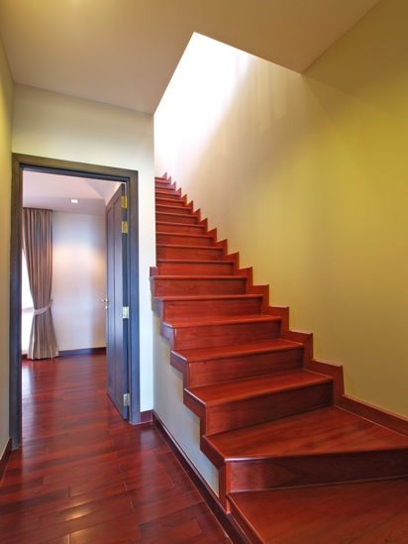
120 sq.m. 2 bedroom Duplex fully furnished

Slide 12
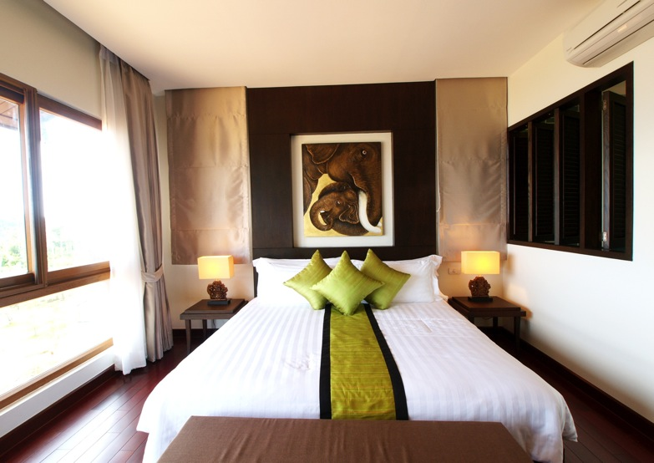
120 sq.m. 2 bedroom Duplex fully furnished

Slide 13
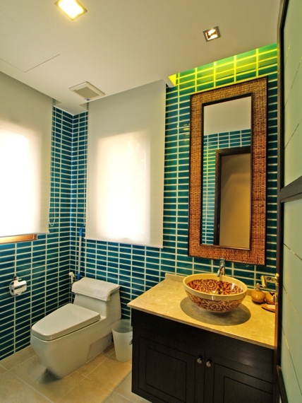
120 sq.m. 2 bedroom Duplex fully furnished

Slide 14
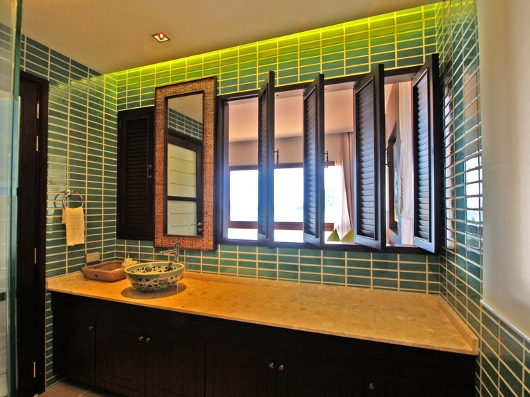
120 sq.m. 2 bedroom Duplex fully furnished

Slide 15
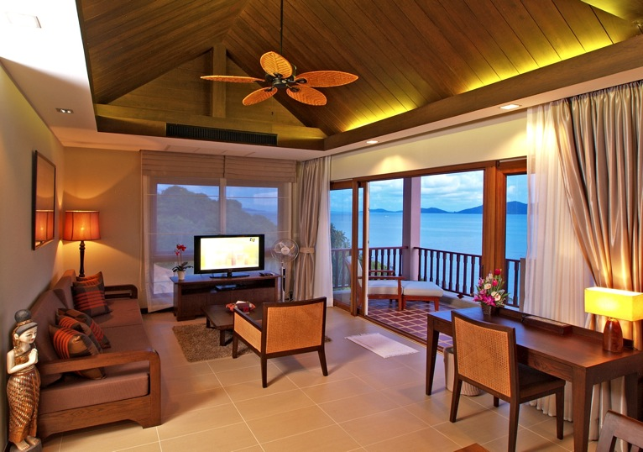
120 sq.m. 2 bedroom Penthouse fully furnished
Price at just Baht 17M.

Slide 16
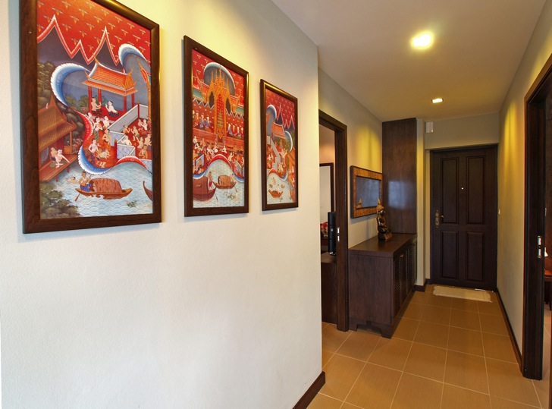
120 sq.m. 2 bedroom Penthouse fully furnished

Slide 17
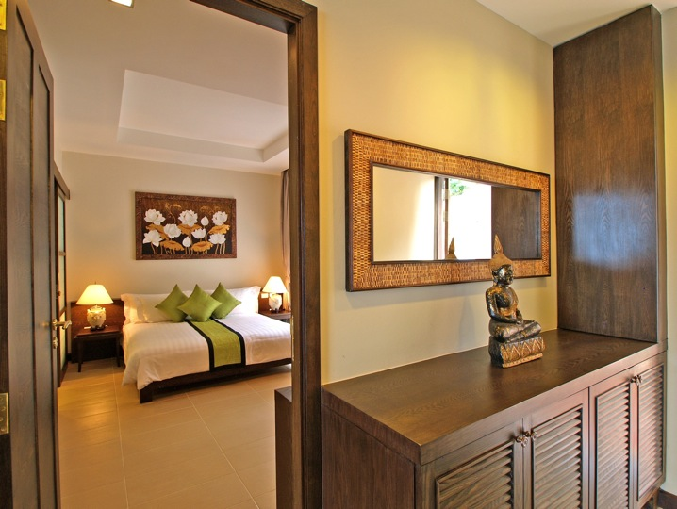
120 sq.m. 2 bedroom Penthouse fully furnished

Slide 18
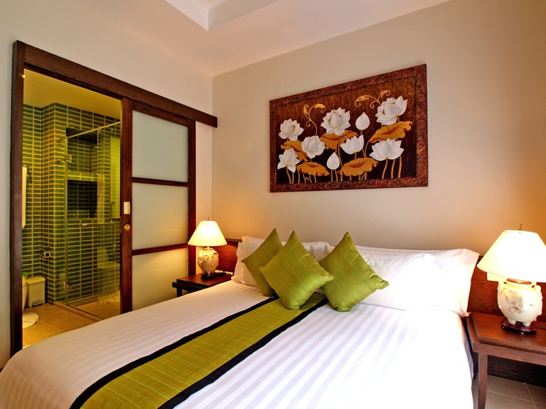
120 sq.m. 2 bedroom Penthouse fully furnished

Slide 19
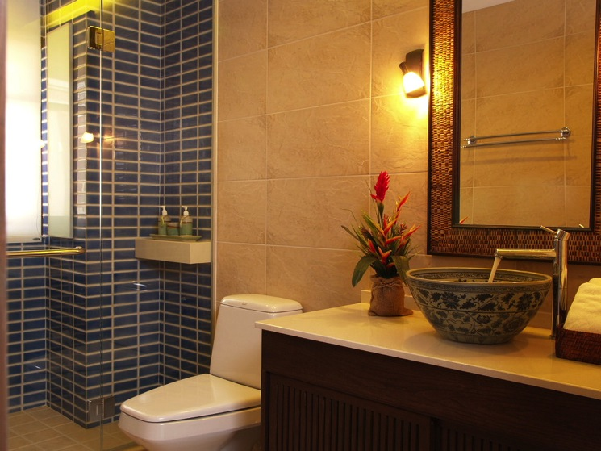
120 sq.m. 2 bedroom Penthouse fully furnished

Slide 20
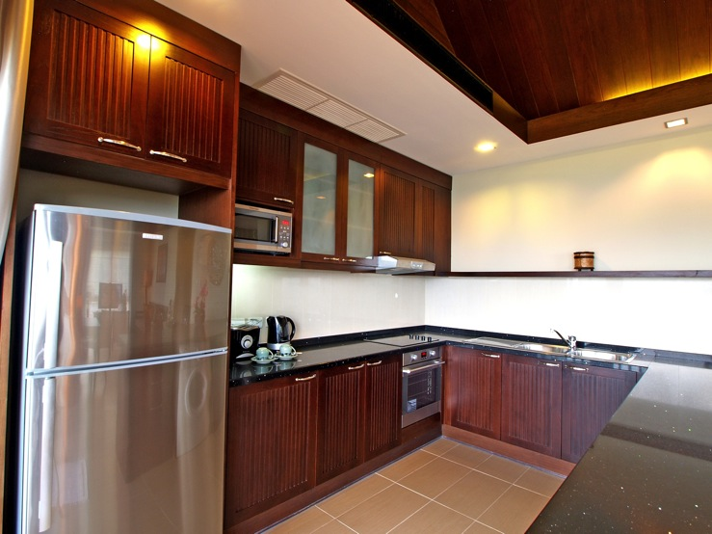
120 sq.m. 2 bedroom Penthouse fully furnished

Slide 21
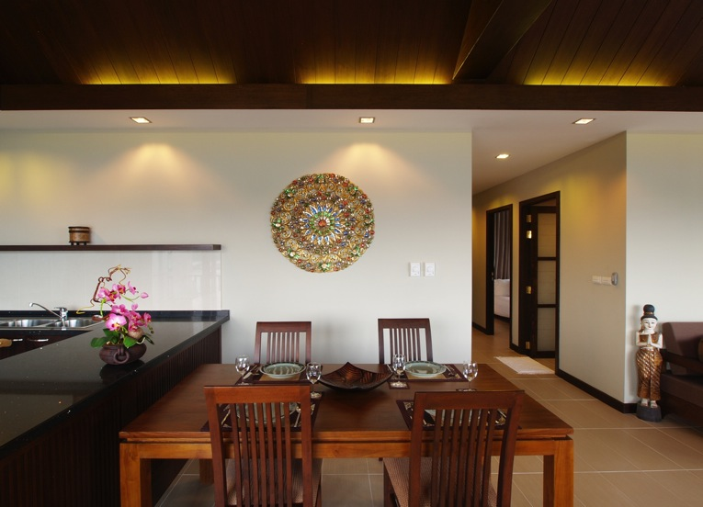
120 sq.m. 2 bedroom Penthouse fully furnished

Slide 22
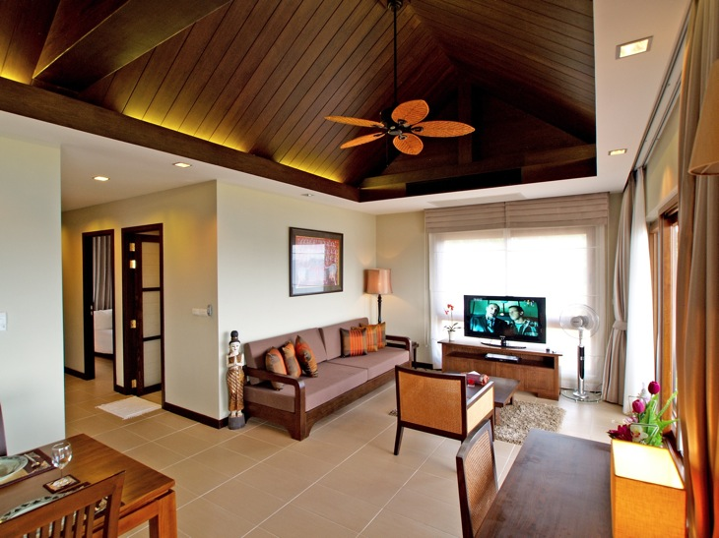
120 sq.m. 2 bedroom Penthouse fully furnished

Slide 23
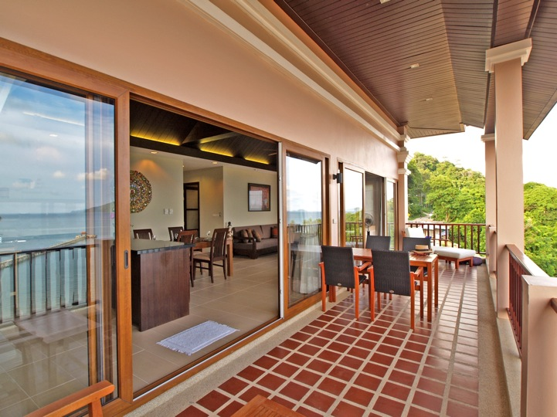
120 sq.m. 2 bedroom Penthouse fully furnished

Slide 24
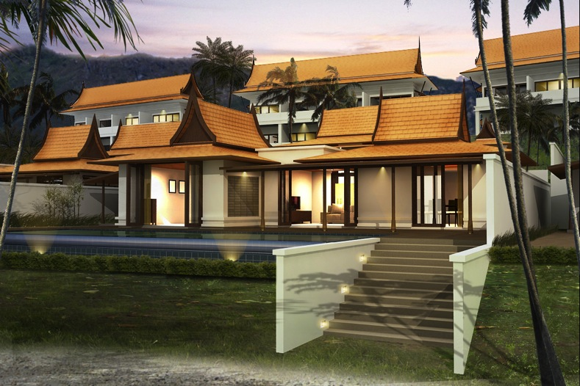
Beachfront Pool Villa 3-4 bedroom (323-558 sq.m.)
Price starts from Baht 38M

Slide 25
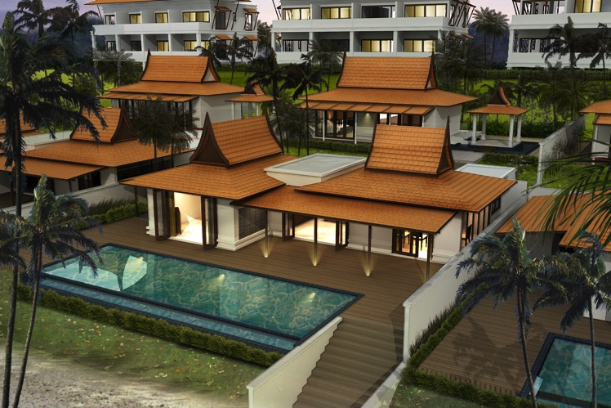
Beachfront Pool Villa 3-4 bedroom (323-558 sq.m.)

Slide 26
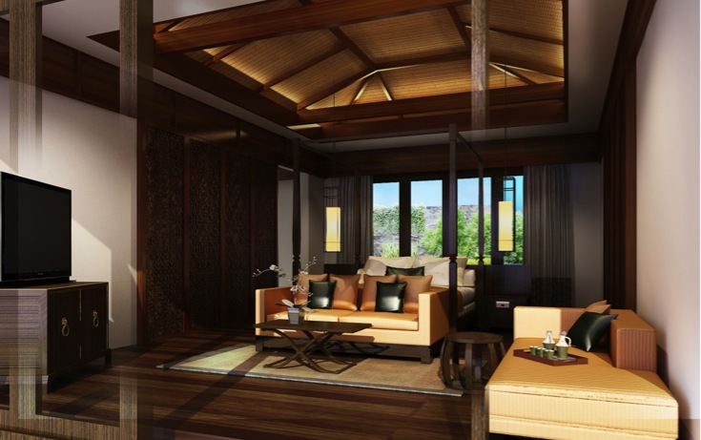
Beachfront Pool Villa 3-4 bedroom (323-558 sq.m.)

Slide 27
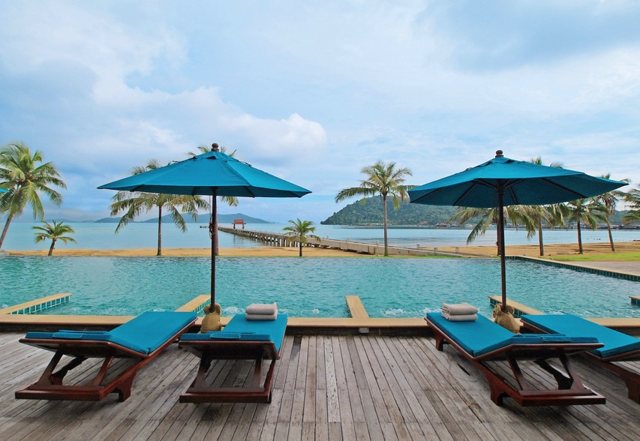
Facilities : 30 Meter Infinity Edge Swimming Pool & Kid’s pool

Slide 28
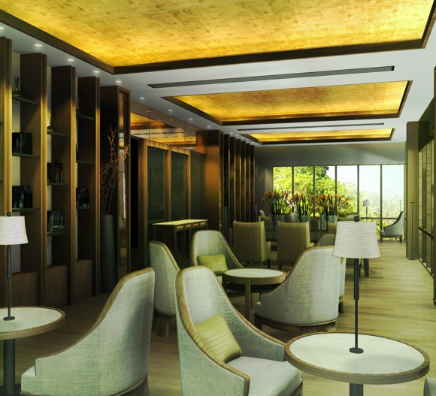
Facilities : Library and Business Center

Slide 29
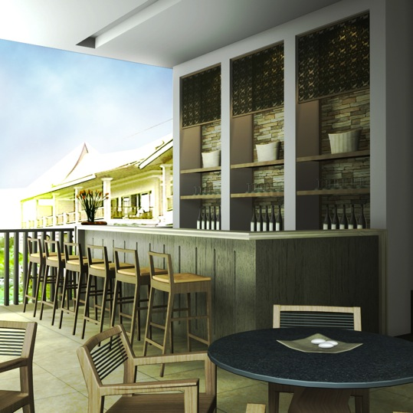
Facilities : Sea View Coffee Lounge

Slide 30

Facilities : Sea View Exercise Room

Slide 31
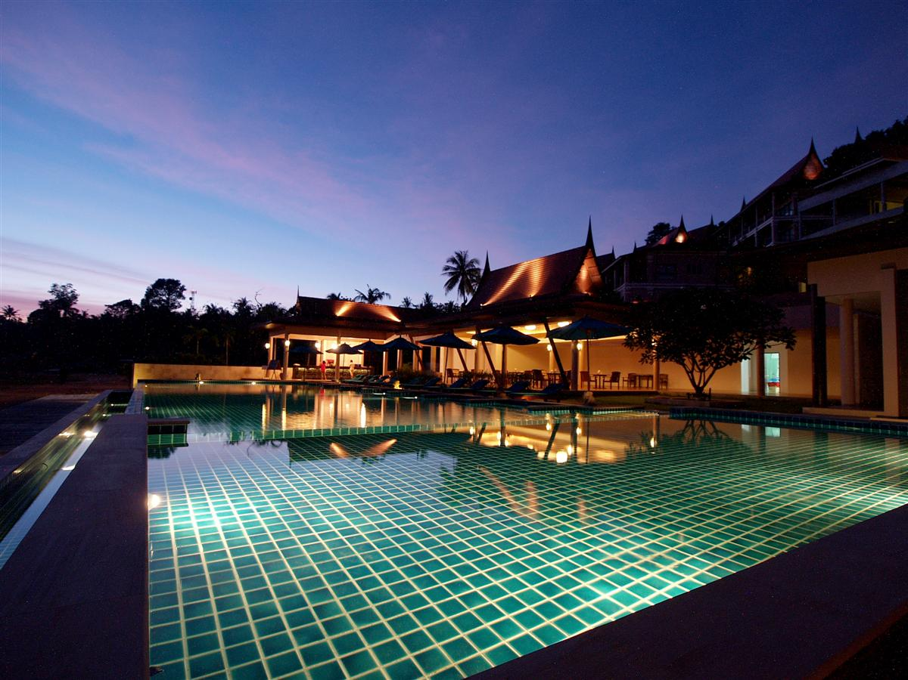
Facilities : Beachfront Restaurant adjacent to the Pool

Slide 32
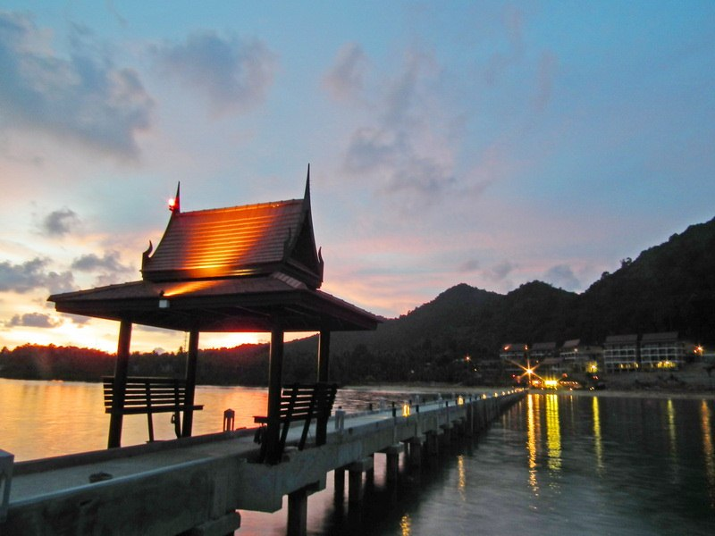
Facilities : 320 Meter Private Pier

